Slide 1
Linear Sorts
Chapter 12.3, 12.4

Slide 2
Linear Sorts?

Slide 3
Linear Sorting Algorithms
Counting Sort
Radix Sort
Bucket Sort

Slide 4
Linear Sorting Algorithms
Counting Sort
Radix Sort
Bucket Sort

Slide 5
Example 1. Counting Sort
Invented by Harold Seward in 1954.
Counting Sort applies when the elements to be sorted come from a finite (and preferably small) set.
For example, the elements to be sorted are integers in the range [0…k-1], for some fixed integer k.
We can then create an array V[0…k-1] and use it to count the number of elements with each value [0…k-1].
Then each input element can be placed in exactly the right place in the output array in constant time.

Slide 6
Counting Sort
Input:
1
0
0
1
3
1
1
3
1
0
2
1
0
1
1
2
2
1
0
Output:
0
0
0
0
0
1
1
1
1
1
1
1
1
1
2
2
3
3
3
Input: N records with integer keys between [0…3].
Output: Stable sorted keys.
Algorithm:
Count frequency of each key value to determine transition locations
Go through the records in order putting them where they go.

Slide 7
CountingSort
Input:
1
0
0
1
3
1
1
3
1
0
2
1
0
1
1
2
2
1
0
Output:
0
0
0
0
0
1
1
1
1
1
1
1
1
1
2
2
2
3
3
Index:
0
1
2
3
4
5
6
7
8
9
10
11
12
13
14
15
16
17
18
Stable sort: If two keys are the same, their order does not change.
Thus the 4th record in input with digit 1 must be
the 4th record in output with digit 1.
It belongs at output index 8, because
8 records go before it
ie, 5 records with a smaller digit & 3 records with the same digit
Count These!

Slide 8
CountingSort
Input:
1
0
0
1
3
1
1
3
1
0
2
1
0
1
1
2
2
1
0
Output:
Index:
0
1
2
3
4
5
6
7
8
9
10
11
12
13
14
15
16
17
18
Value v:
0
1
2
3
# of records with digit v:
5
9
3
2
N records. Time to count?
θ(N)

Slide 9
CountingSort
Input:
1
0
0
1
3
1
1
3
1
0
2
1
0
1
1
2
2
1
0
Output:
Index:
0
1
2
3
4
5
6
7
8
9
10
11
12
13
14
15
16
17
18
Value v:
0
1
2
3
# of records with digit v:
5
9
3
3
# of records with digit < v:
0
5
14
17
N records, k different values. Time to count?
θ(k)

Slide 10
CountingSort
Input:
1
0
0
1
3
1
1
3
1
0
2
1
0
1
1
2
2
1
0
Output:
0
0
0
0
0
1
1
1
1
1
1
1
1
1
2
2
2
3
3
Index:
0
1
2
3
4
5
6
7
8
9
10
11
12
13
14
15
16
17
18
Value v:
0
1
2
3
# of records with digit < v:
0
5
14
17
= location of first record with digit v.

Slide 11
CountingSort
Input:
1
0
0
1
3
1
1
3
1
0
2
1
0
1
1
2
2
1
0
Output:
0
?
1
Index:
0
1
2
3
4
5
6
7
8
9
10
11
12
13
14
15
16
17
18
Value v:
0
1
2
3
Location of first record with digit v.
0
5
14
17
Algorithm: Go through the records in order putting them where they go.

Slide 12
Loop Invariant
The first i-1 keys have been placed in the correct locations in the output array
The auxiliary data structure v indicates the location at which to place the i^{th} key for each possible key value from [0..k-1].

Slide 13
CountingSort
Input:
1
0
0
1
3
1
1
3
1
0
2
1
0
1
1
2
2
1
0
Output:
1
Index:
0
1
2
3
4
5
6
7
8
9
10
11
12
13
14
15
16
17
18
Value v:
0
1
2
3
Location of next record with digit v.
0
5
14
17
Algorithm: Go through the records in order putting them where they go.

Slide 14
CountingSort
Input:
1
0
0
1
3
1
1
3
1
0
2
1
0
1
1
2
2
1
0
Output:
0
1
Index:
0
1
2
3
4
5
6
7
8
9
10
11
12
13
14
15
16
17
18
Value v:
0
1
2
3
Location of next record with digit v.
0
6
14
17
Algorithm: Go through the records in order putting them where they go.

Slide 15
CountingSort
Input:
1
0
0
1
3
1
1
3
1
0
2
1
0
1
1
2
2
1
0
Output:
0
0
1
Index:
0
1
2
3
4
5
6
7
8
9
10
11
12
13
14
15
16
17
18
Value v:
0
1
2
3
Location of next record with digit v.
1
6
14
17
Algorithm: Go through the records in order putting them where they go.

Slide 16
CountingSort
Input:
1
0
0
1
3
1
1
3
1
0
2
1
0
1
1
2
2
1
0
Output:
0
0
1
1
Index:
0
1
2
3
4
5
6
7
8
9
10
11
12
13
14
15
16
17
18
Value v:
0
1
2
3
Location of next record with digit v.
2
6
14
17
Algorithm: Go through the records in order putting them where they go.

Slide 17
CountingSort
Input:
1
0
0
1
3
1
1
3
1
0
2
1
0
1
1
2
2
1
0
Output:
0
0
1
1
3
Index:
0
1
2
3
4
5
6
7
8
9
10
11
12
13
14
15
16
17
18
Value v:
0
1
2
3
Location of next record with digit v.
2
7
14
17
Algorithm: Go through the records in order putting them where they go.

Slide 18
CountingSort
Input:
1
0
0
1
3
1
1
3
1
0
2
1
0
1
1
2
2
1
0
Output:
0
0
1
1
1
3
Index:
0
1
2
3
4
5
6
7
8
9
10
11
12
13
14
15
16
17
18
Value v:
0
1
2
3
Location of next record with digit v.
2
7
14
18
Algorithm: Go through the records in order putting them where they go.

Slide 19
CountingSort
Input:
1
0
0
1
3
1
1
3
1
0
2
1
0
1
1
2
2
1
0
Output:
0
0
1
1
1
1
3
Index:
0
1
2
3
4
5
6
7
8
9
10
11
12
13
14
15
16
17
18
Value v:
0
1
2
3
Location of next record with digit v.
2
8
14
18
Algorithm: Go through the records in order putting them where they go.

Slide 20
CountingSort
Input:
1
0
0
1
3
1
1
3
1
0
2
1
0
1
1
2
2
1
0
Output:
0
0
1
1
1
1
3
3
Index:
0
1
2
3
4
5
6
7
8
9
10
11
12
13
14
15
16
17
18
Value v:
0
1
2
3
Location of next record with digit v.
2
9
14
18
Algorithm: Go through the records in order putting them where they go.

Slide 21
CountingSort
Input:
1
0
0
1
3
1
1
3
1
0
2
1
0
1
1
2
2
1
0
Output:
0
0
1
1
1
1
1
3
3
Index:
0
1
2
3
4
5
6
7
8
9
10
11
12
13
14
15
16
17
18
Value v:
0
1
2
3
Location of next record with digit v.
2
9
14
19
Algorithm: Go through the records in order putting them where they go.

Slide 22
CountingSort
Input:
1
0
0
1
3
1
1
3
1
0
2
1
0
1
1
2
2
1
0
Output:
0
0
0
1
1
1
1
1
3
3
Index:
0
1
2
3
4
5
6
7
8
9
10
11
12
13
14
15
16
17
18
Value v:
0
1
2
3
Location of next record with digit v.
2
10
14
19
Algorithm: Go through the records in order putting them where they go.

Slide 23
CountingSort
Input:
1
0
0
1
3
1
1
3
1
0
2
1
0
1
1
2
2
1
0
Output:
0
0
0
1
1
1
1
1
2
3
3
Index:
0
1
2
3
4
5
6
7
8
9
10
11
12
13
14
15
16
17
18
Value v:
0
1
2
3
Location of next record with digit v.
3
10
14
19
Algorithm: Go through the records in order putting them where they go.

Slide 24
CountingSort
Input:
1
0
0
1
3
1
1
3
1
0
2
1
0
1
1
2
2
1
0
Output:
0
0
0
1
1
1
1
1
1
2
3
3
Index:
0
1
2
3
4
5
6
7
8
9
10
11
12
13
14
15
16
17
18
Value v:
0
1
2
3
Location of next record with digit v.
3
10
15
19
Algorithm: Go through the records in order putting them where they go.

Slide 25
CountingSort
Input:
1
0
0
1
3
1
1
3
1
0
2
1
0
1
1
2
2
1
0
Output:
0
0
0
1
1
1
1
1
1
2
3
3
Index:
0
1
2
3
4
5
6
7
8
9
10
11
12
13
14
15
16
17
18
Value v:
0
1
2
3
Location of next record with digit v.
3
10
15
19
Algorithm: Go through the records in order putting them where they go.

Slide 26
CountingSort
Input:
1
0
0
1
3
1
1
3
1
0
2
1
0
1
1
2
2
1
0
Output:
0
0
0
0
0
1
1
1
1
1
1
1
1
1
2
2
2
3
3
Index:
0
1
2
3
4
5
6
7
8
9
10
11
12
13
14
15
16
17
18
Value v:
0
1
2
3
Location of next record with digit v.
5
14
17
19
Time =
θ(N)
Total =
θ(N+k)

Slide 27
Linear Sorting Algorithms
Counting Sort
Radix Sort
Bucket Sort

Slide 28
Example 2. RadixSort
125 224 225 325
333 134 334
344 143 243
344 125 333 134 224 334 143 225 325 243
Input:
An array of N numbers.
Each number contains d digits.
Each digit between [0…k-1]
Output:
Sorted numbers.
Digit Sort:
Select one digit
Separate numbers into k piles
based on selected digit (e.g., Counting Sort).
Stable sort: If two cards are the same for that digit, their order does not change.

Slide 29
RadixSort
344 125 333 134 224 334 143 225 325 243
125 134 143 224 225 243 344 333 334 325
125 224 225 325 134 333 334 143 243 344
Sort wrt which digit first?
Sort wrt which digit Second?
The most significant.
The next most significant.
All meaning in first sort lost.

Slide 30
RadixSort
344 125 333 134 224 334 143 225 325 243
333 143 243 344 134 224 334 125 225 325
224 125 225 325 333 134 334 143 243 344
Sort wrt which digit first?
Sort wrt which digit Second?
The least significant.
The next least significant.

Slide 31
RadixSort
344 125 333 134 224 334 143 225 325 243
333 143 243 344 134 224 334 125 225 325
2 24 1 25 2 25 3 25 3 33 1 34 3 34 1 43 2 43 3 44
Sort wrt which digit first?
Sort wrt which digit Second?
The least significant.
The next least significant.
Is sorted wrt least sig. 2 digits.

Slide 32
RadixSort
2 24 1 25 2 25 3 25 3 33 1 34 3 34 1 43 2 43 3 44
1 25 1 34 1 43
2 24 2 25 2 43
3 25 3 33 3 34 3 44
Is sorted wrt first i digits.
Is sorted wrt first i+1 digits.
These are in the correct order because sorted wrt high order digit
Sort wrt i+1st digit.
i+1

Slide 33
RadixSort
2 24 1 25 2 25 3 25 3 33 1 34 3 34 1 43 2 43 3 44
1 25 1 34 1 43
2 24 2 25 2 43
3 25 3 33 3 34 3 44
Is sorted wrt first i digits.
Is sorted wrt first i+1 digits.
These are in the correct order because was sorted & stable sort left sorted
Sort wrt i+1st digit.
i+1

Slide 34
Loop Invariant
The keys have been correctly stable-sorted with respect to the i-1 least-significant digits.

Slide 35
Running Time

Slide 36
Linear Sorting Algorithms
Counting Sort
Radix Sort
Bucket Sort

Slide 37
Example 3. Bucket Sort
Applicable if input is constrained to finite interval, e.g., real numbers in the range [0…1).
If input is random and uniformly distributed, expected run time is Θ(n).

Slide 38
Bucket Sort

Slide 39
Loop Invariants
Loop 1
The first i-1 keys have been correctly placed into buckets of width 1/n.
Loop 2
The keys within each of the first i-1 buckets have been correctly stable-sorted.

Slide 40
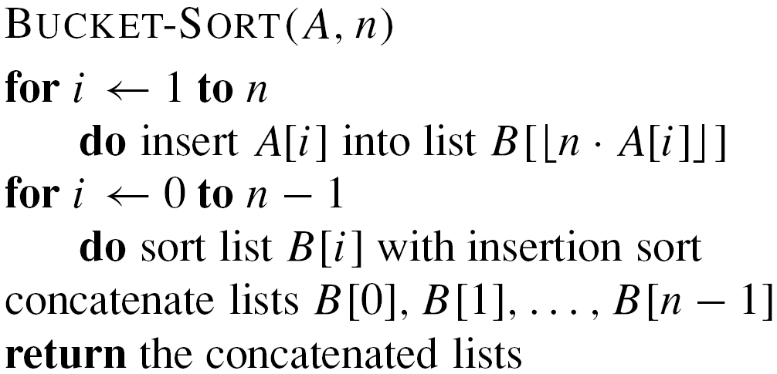
PseudoCode
Expected Running Time

Slide 41
Linear Sorting Algorithms
Counting Sort
Radix Sort
Bucket Sort

Slide 42
Linear Sorts: Learning Outcomes
You should be able to:
Explain the difference between comparison sorts and linear sorting methods.
Identify situations when linear sorting methods can be applied and know why.
Explain and/or code any of the linear sorting algorithms we have covered.

